Slide 1
ADVANCED JAVA PROGRAMMING SEMINAR
- TEAM 3

Slide 2
PROGRAM -7
. Create a table in the database containing the columns to store book details like: book name, authors, description, price and URL of the book’s cover image. Using JSP and JDBC retrieve the details in the table and display them on the webpage.

Slide 3
STEPS INVOLVED:
Create a database with the book details in mysql.
Using the mysql-connector-java.jar file, connect the database to the jsp program.
Get the information in the database and display it , involving both jsp and jdbc.

Slide 4
SOFTWARE USED:
NETBEANS
APACHE TOMCAT
NETBEANS
PHPMYADMIN
BROWSER

Slide 5
code

Slide 6
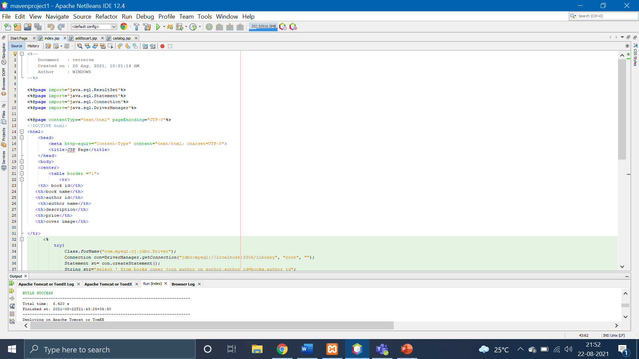

Slide 7
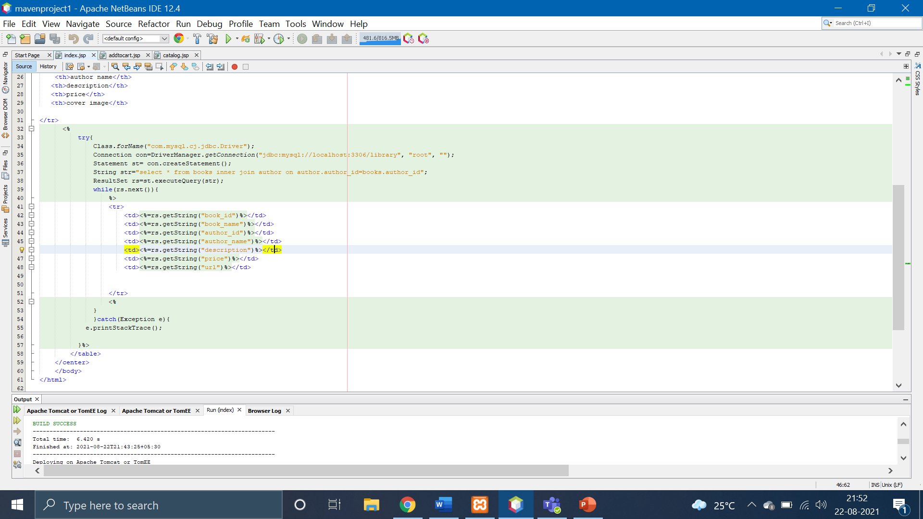

Slide 8
DATABASE:

Slide 9
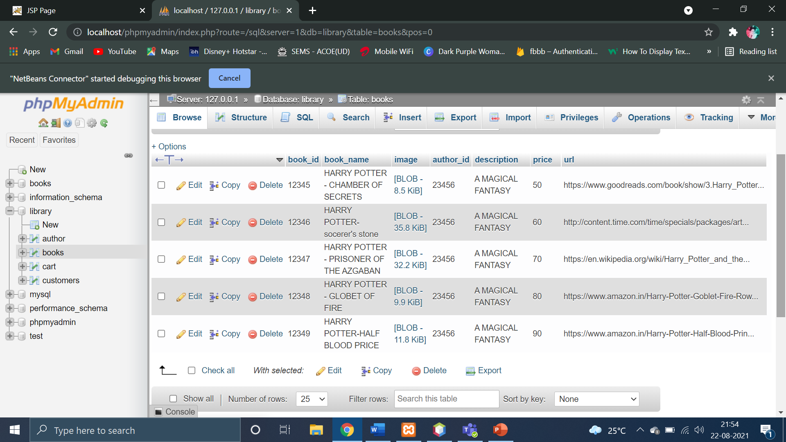

Slide 10
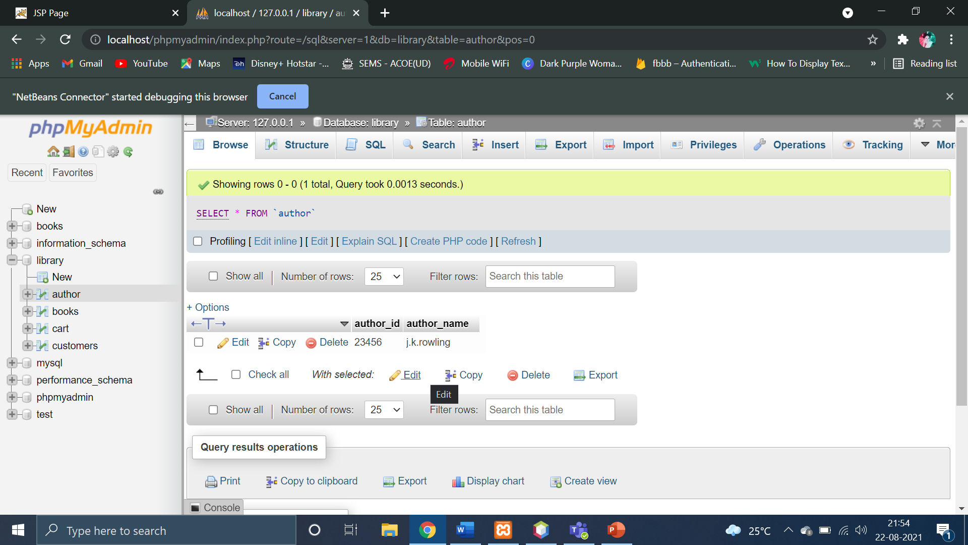

Slide 11
OUTPUT

Slide 12
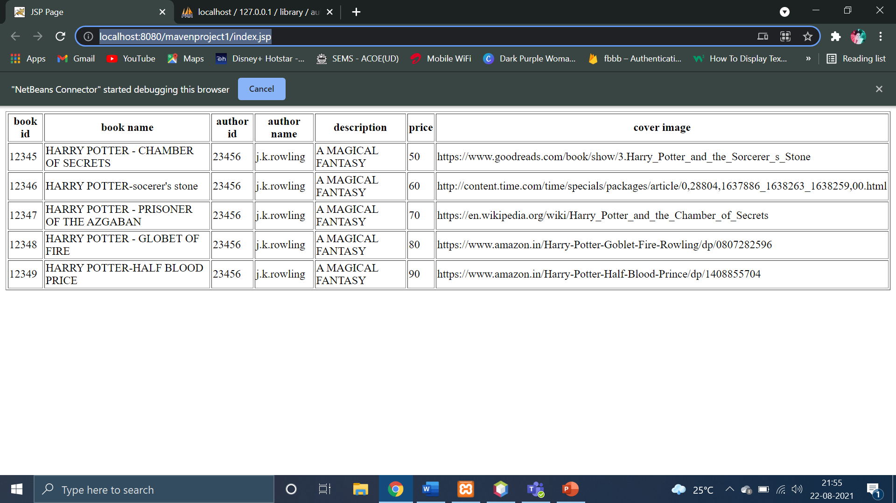

Slide 13
THANK YOU!

